Slide 1
DevelopHER 2016
Proudly sponsored by MYOB

Slide 2


Slide 3
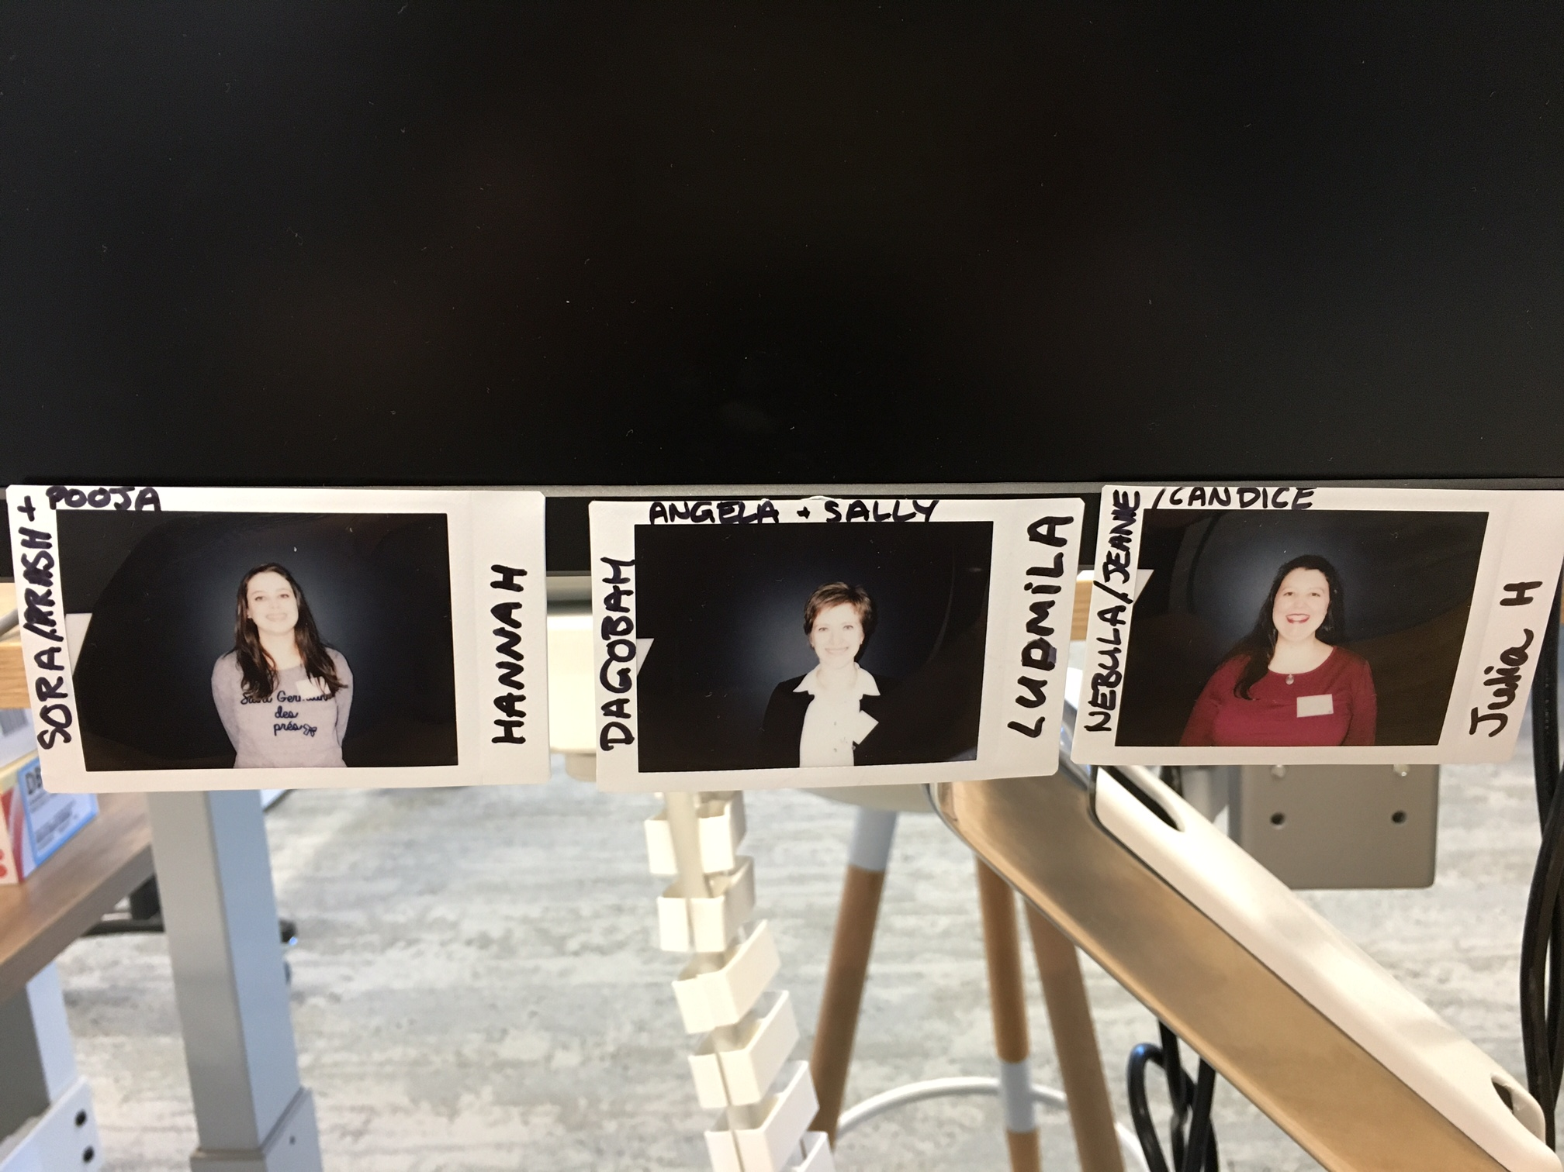
Chosen DevelopHERs
Hannah Deutscher
Ludmila Stakhovych
Julia Harper
Photos taken on the interview day, showing us full of excitement and hope! We had no idea they would be a permanent fixture on Tanya’s desk! The first of many great poses

Slide 4
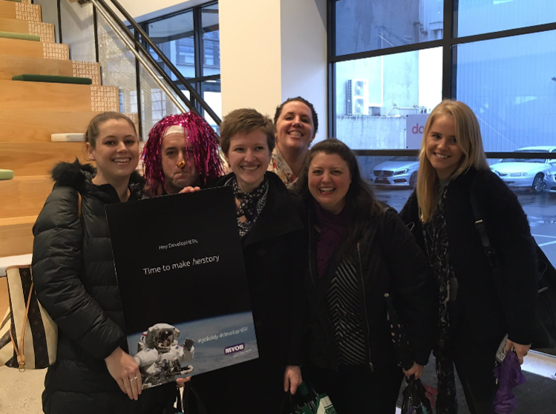
First day as DevelopHERs
It was our first day at MYOB as DevelopHER interns.
Here comes the description.

Slide 5
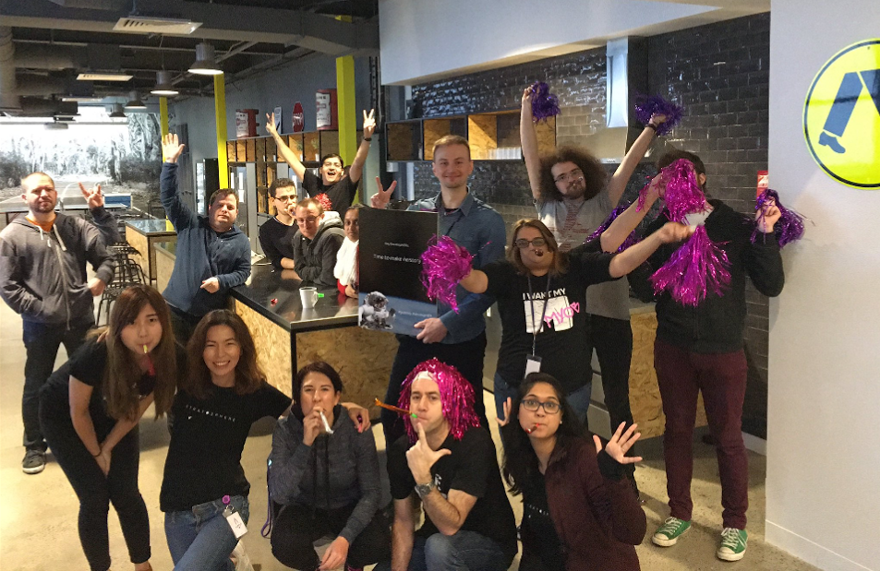
DevelopHERs welcoming celebration
An epicly enthusiastic welcome from the team we would come to know and love! Don’t’ worry Andrew, we can still see you behind Mandy’s third arm, and Dan is managing to keep both hands in his pockets whilst also giving a rock salute ☺

Slide 6
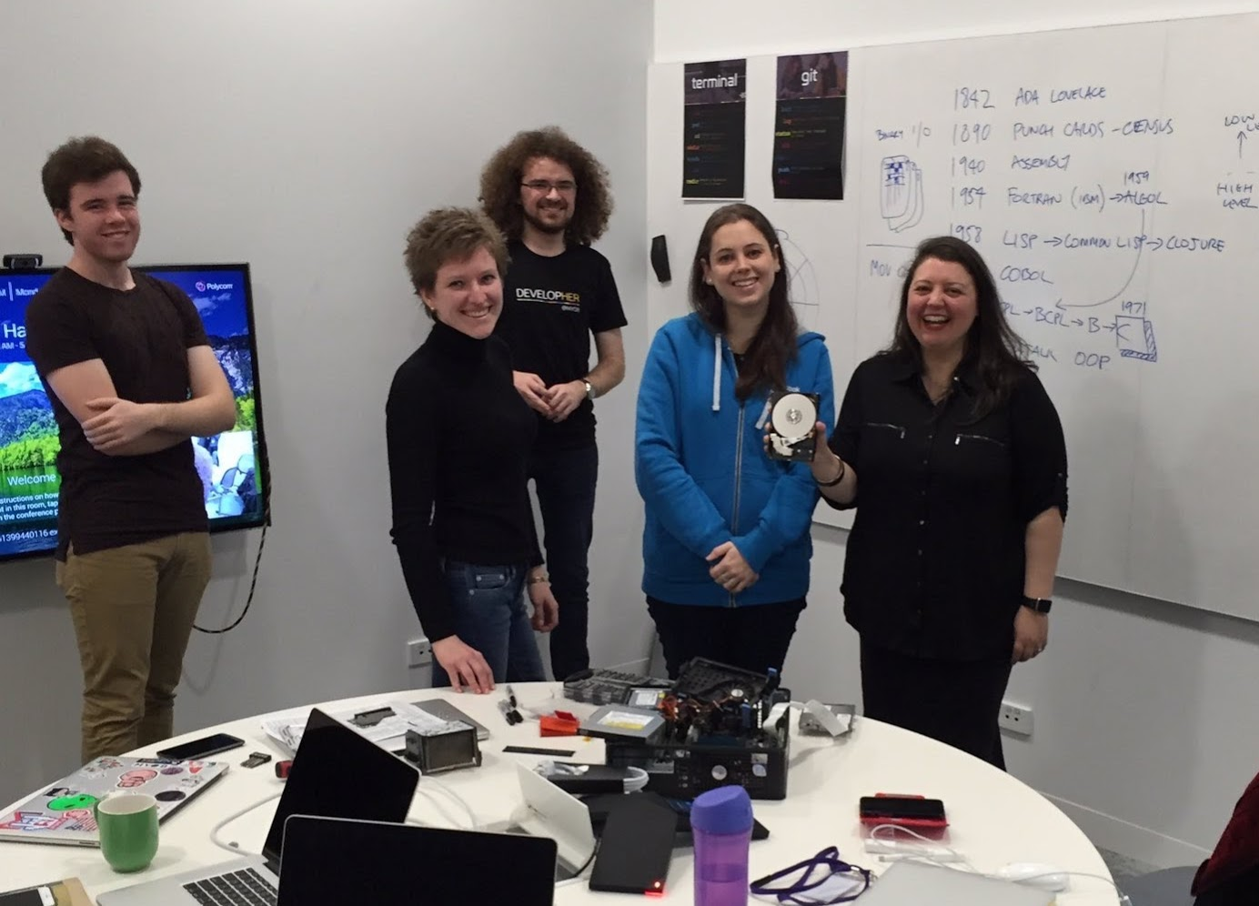
Classroom session
First day in the classroom – history of SW development

Slide 7
Learning Agile Manifesto Terminal & Git Commands

Slide 8
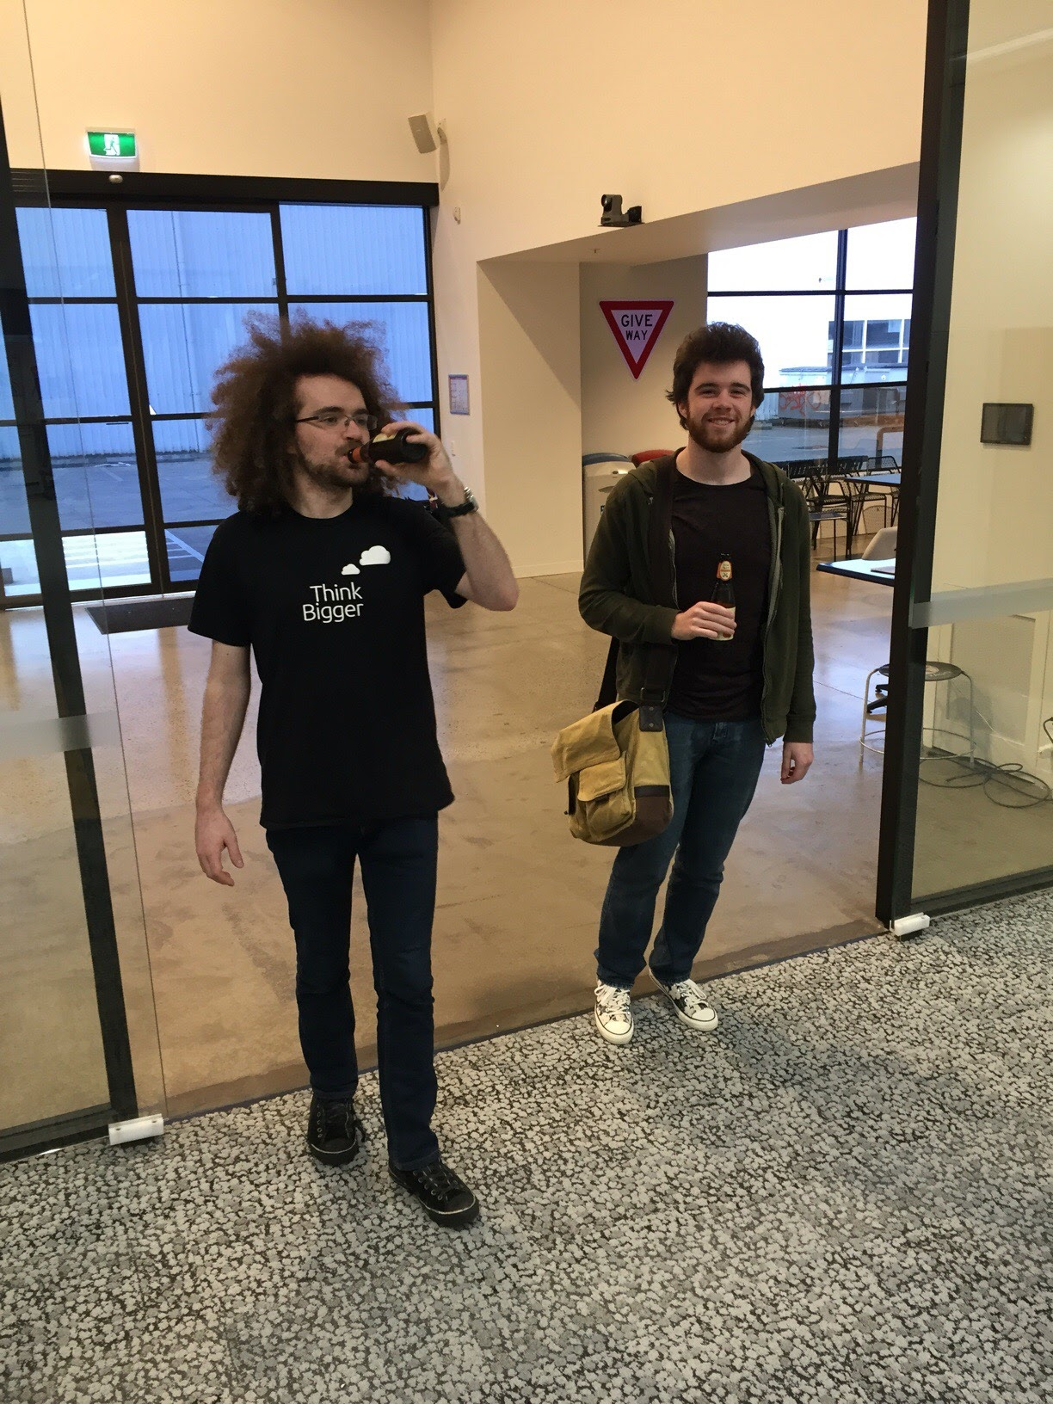
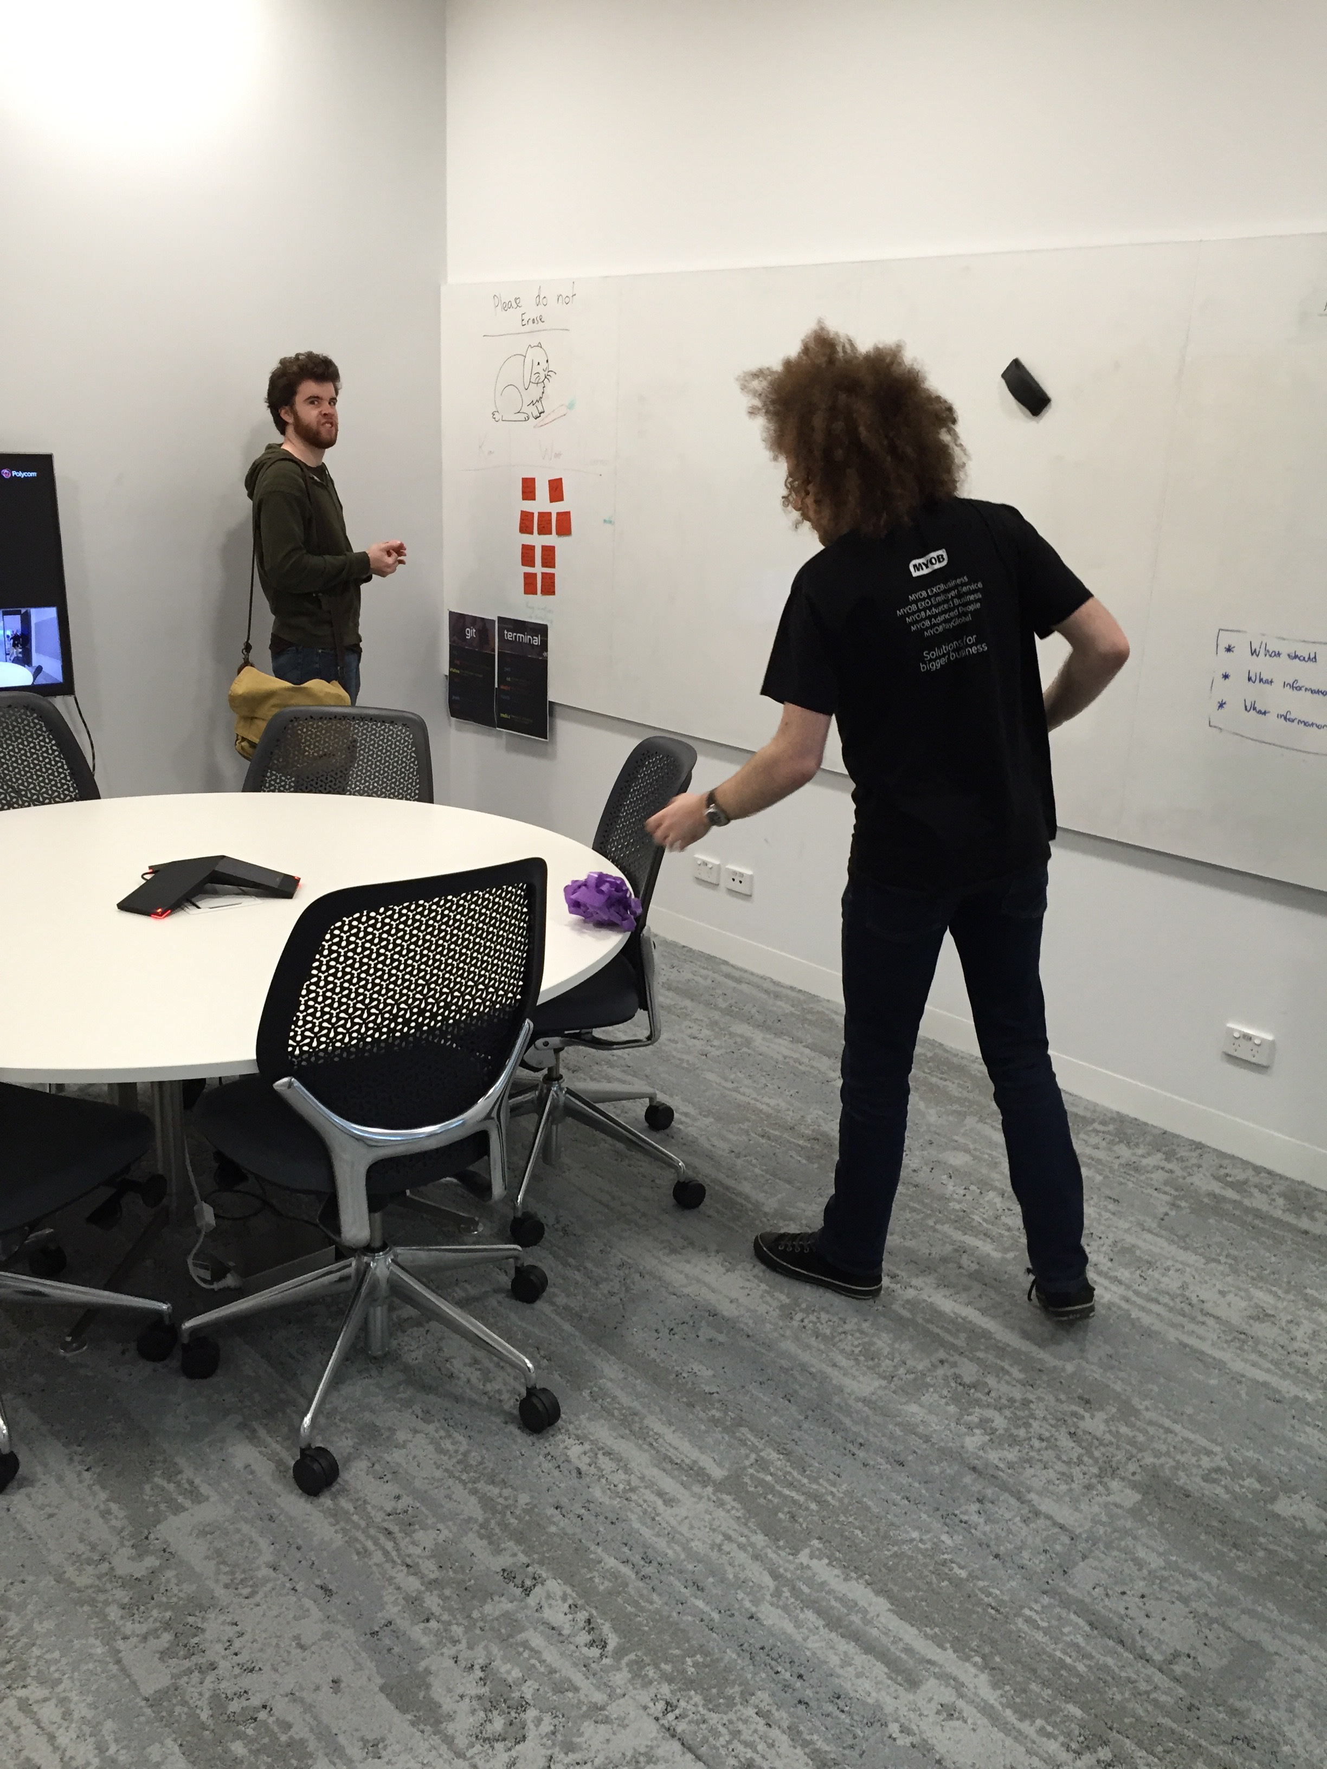
Teachers
description

Slide 9
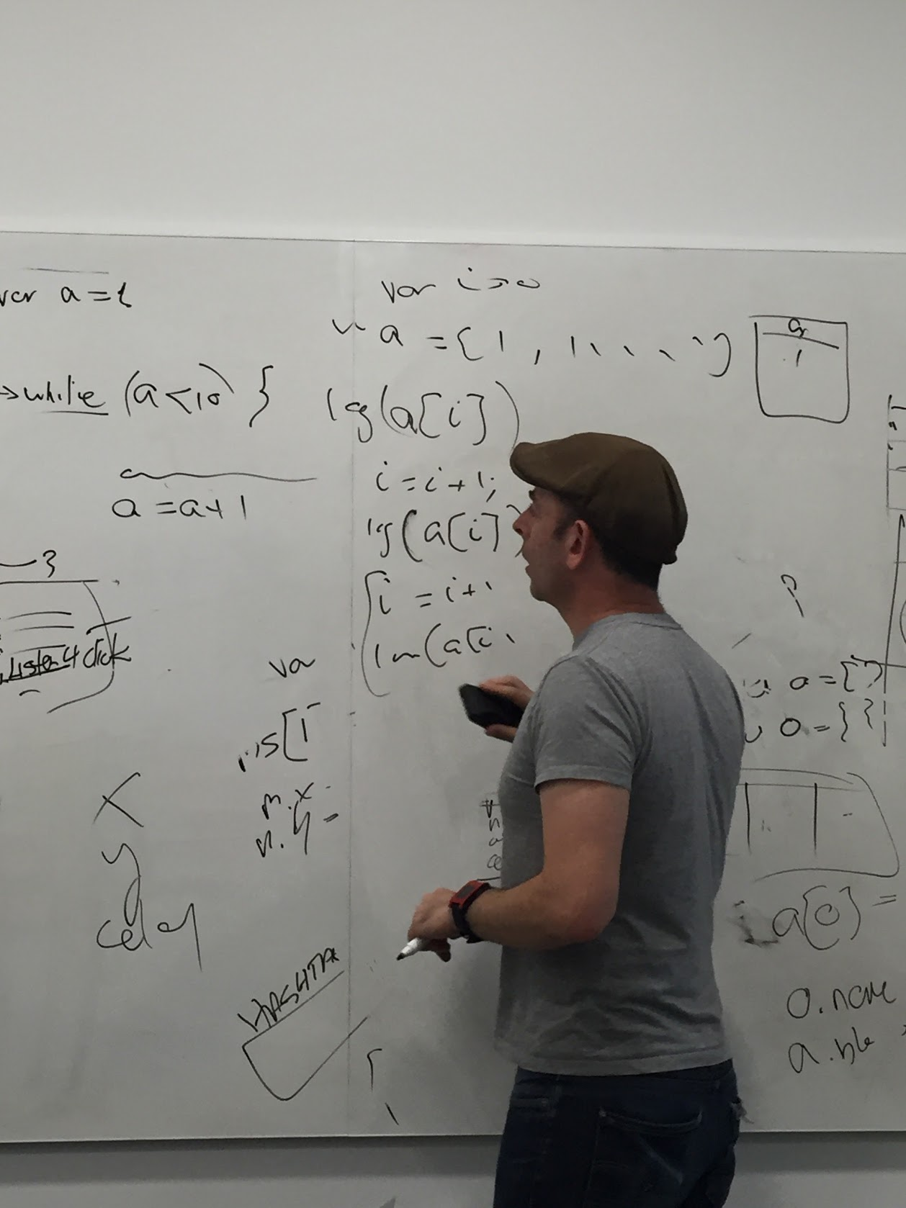
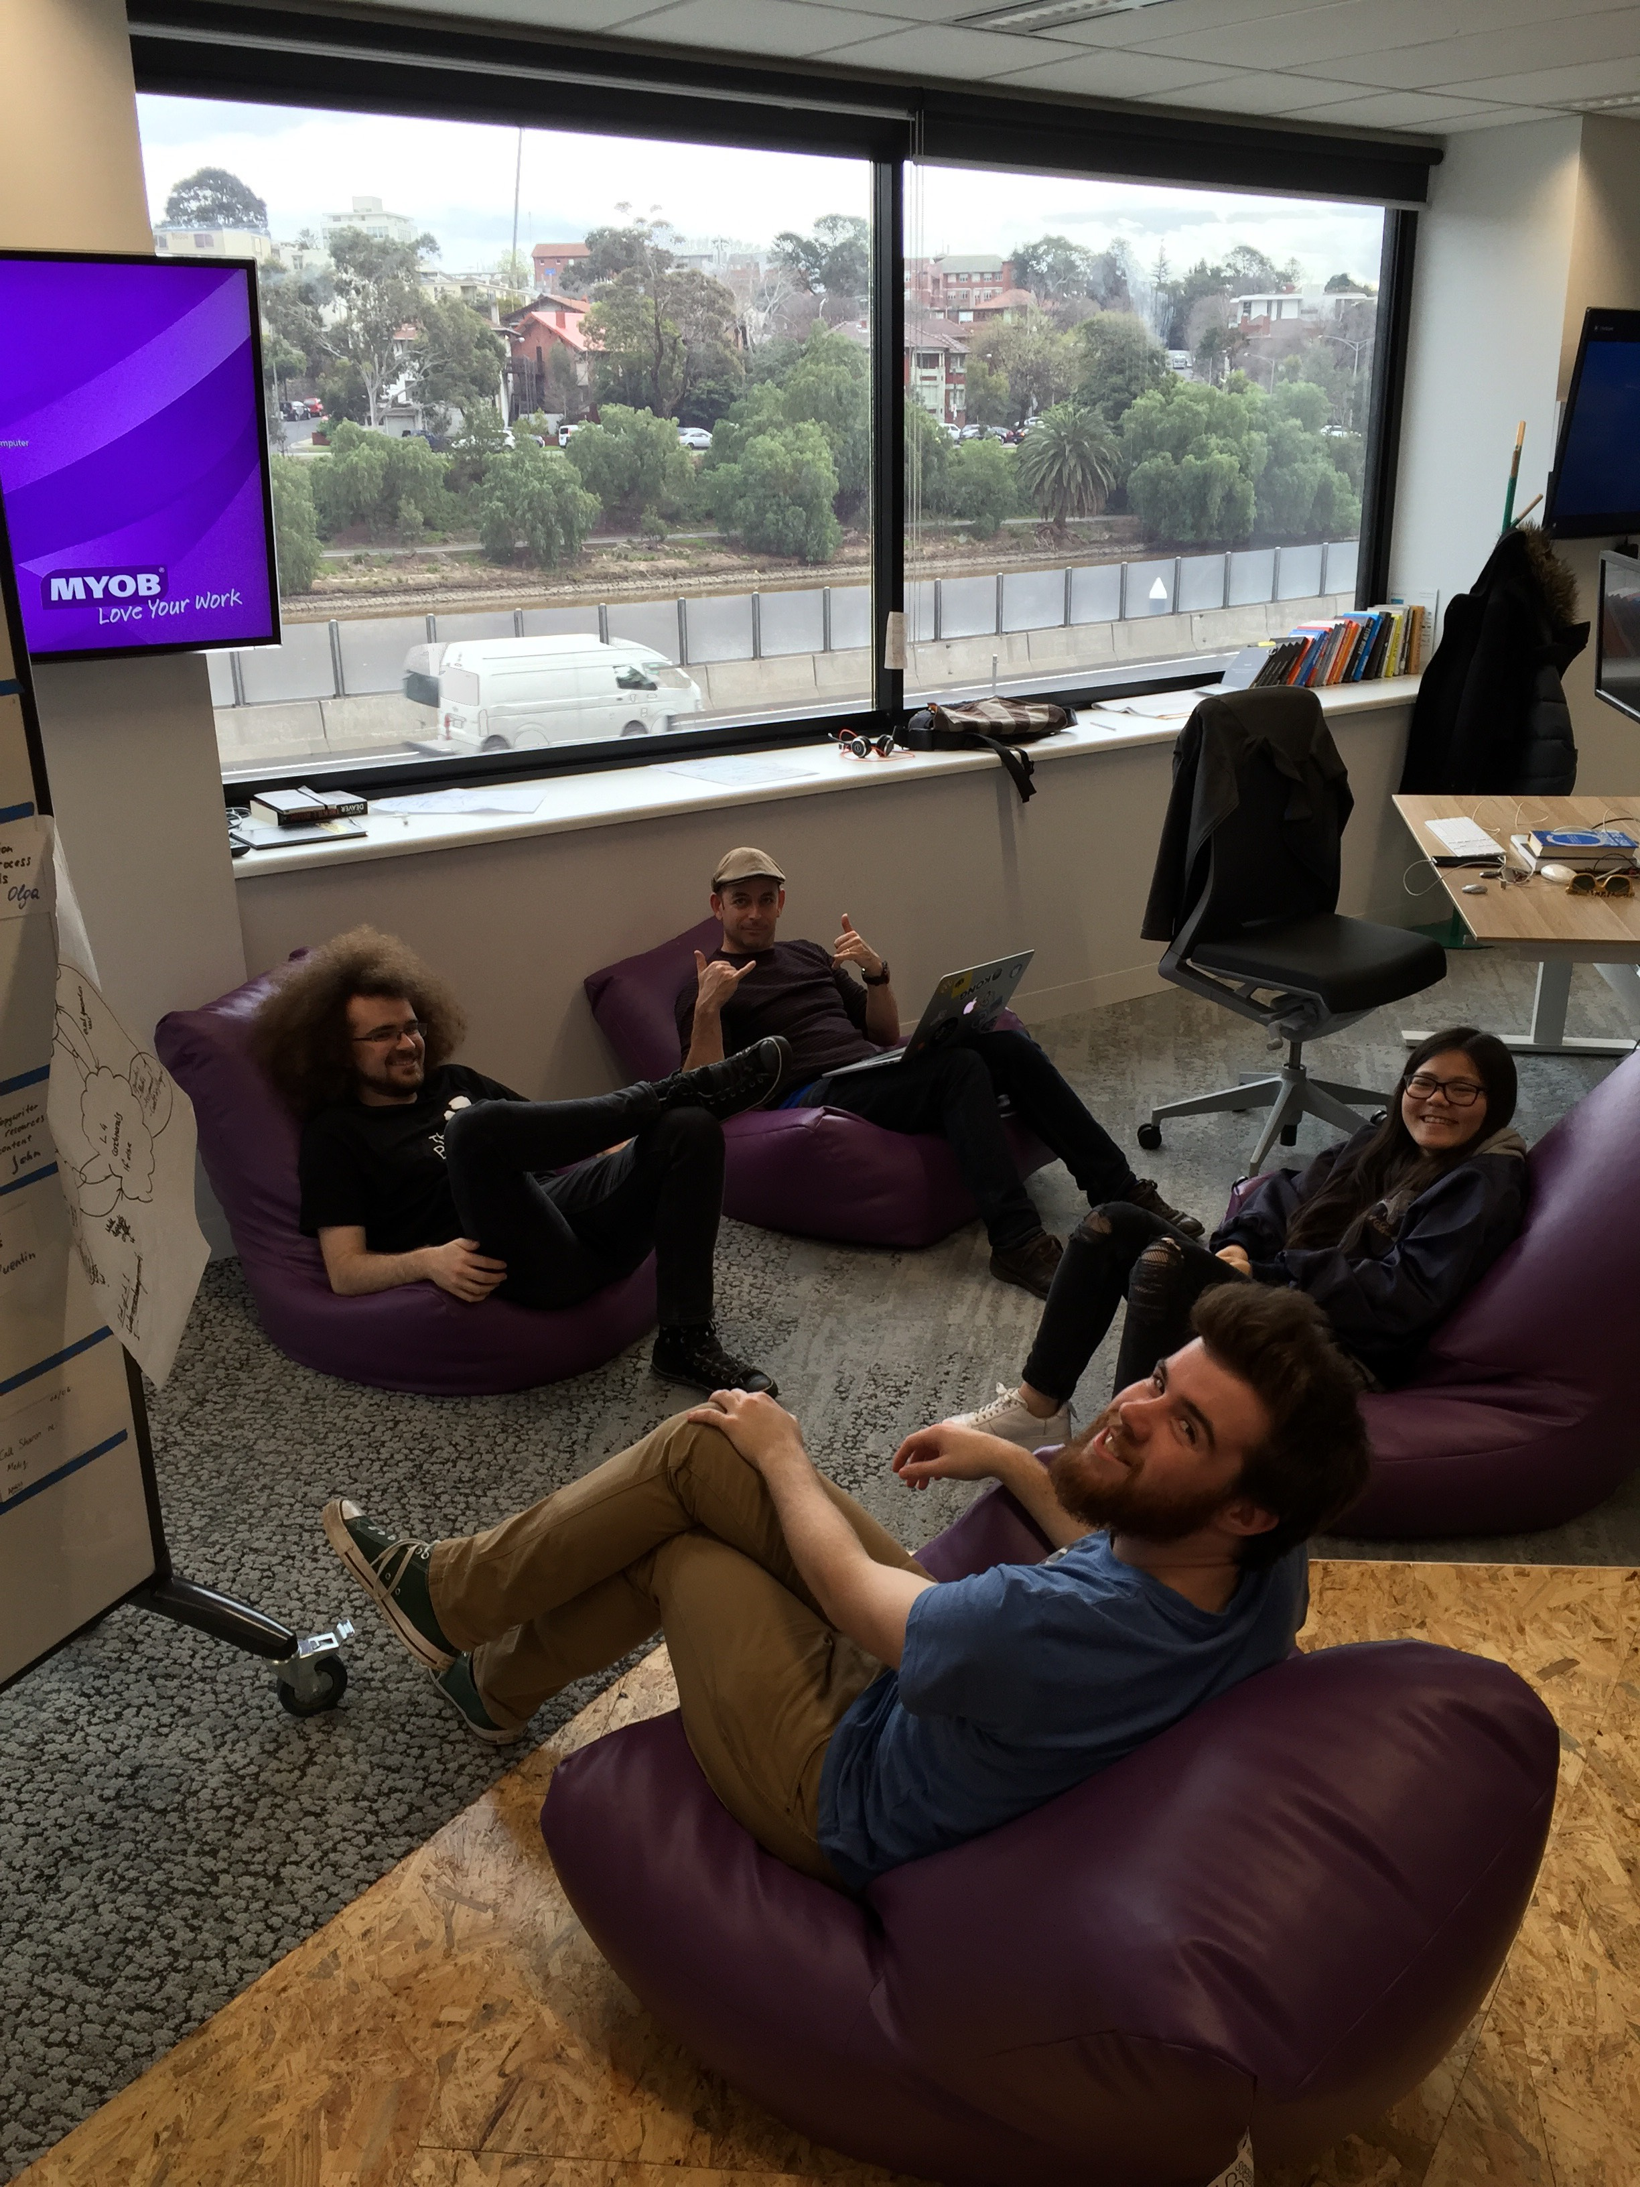
SRA
The atmosphere is ramping up, things are being put into boxes using equals, and there’s the sound of cyborg camera lenses scanning the room. SRA is in the house!

Slide 10
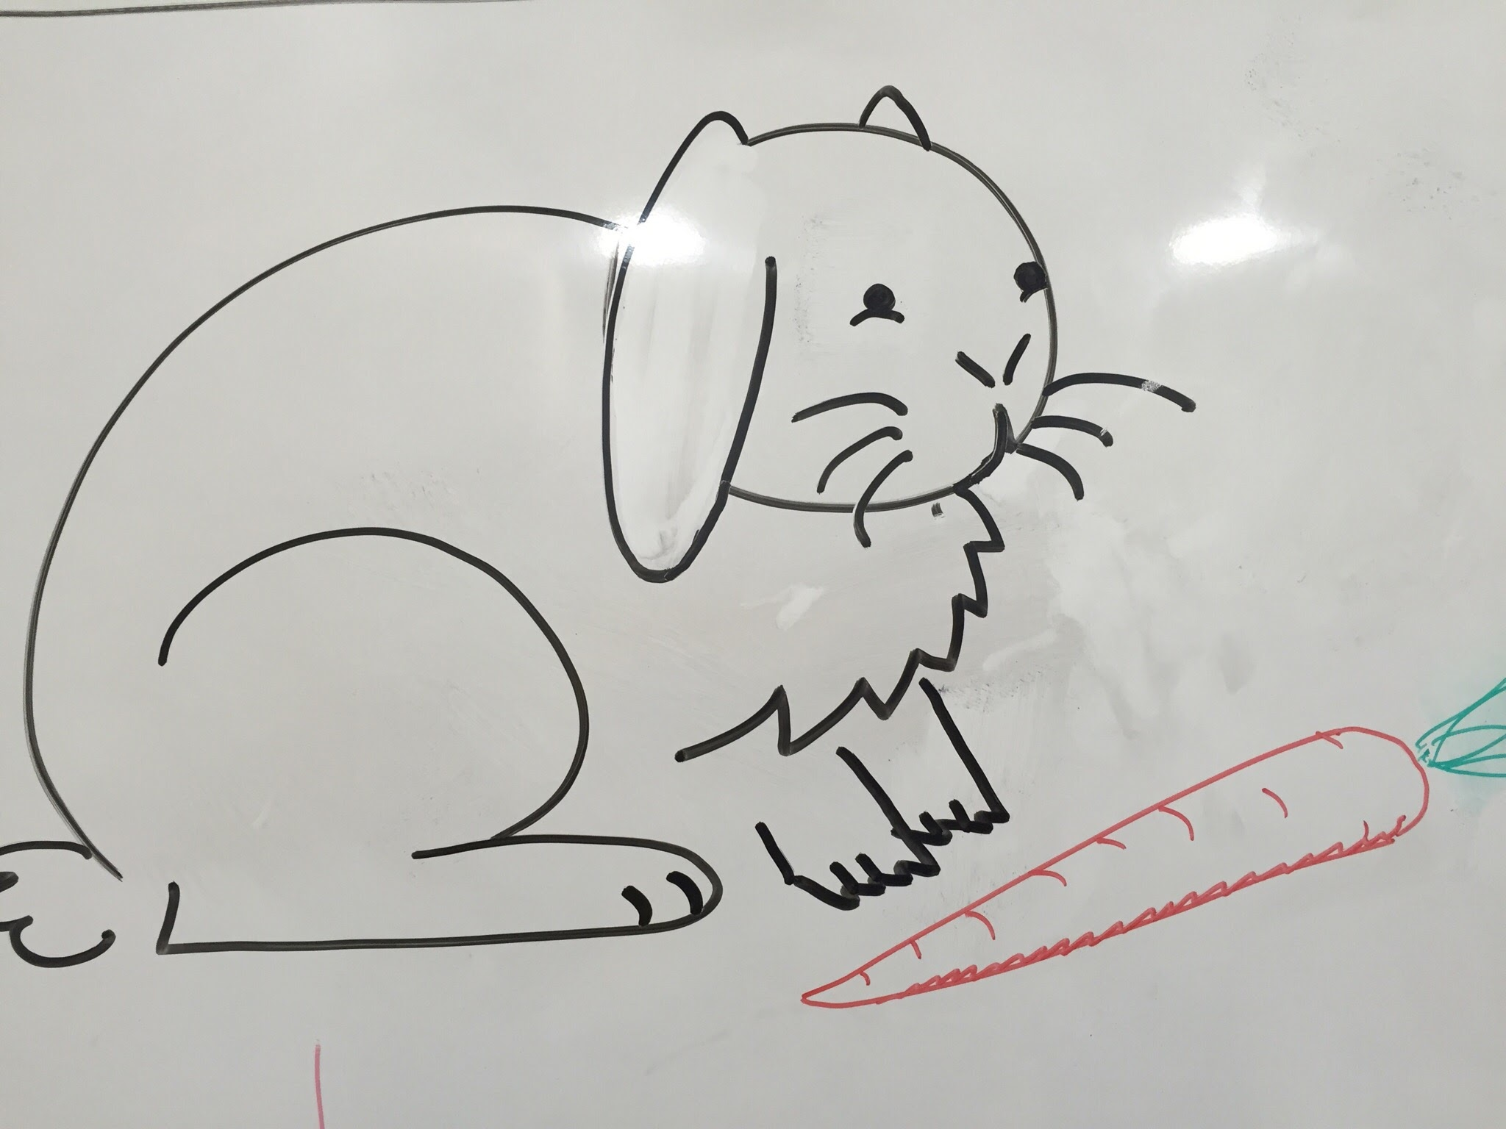
Lovely rabbit
Description

Slide 11
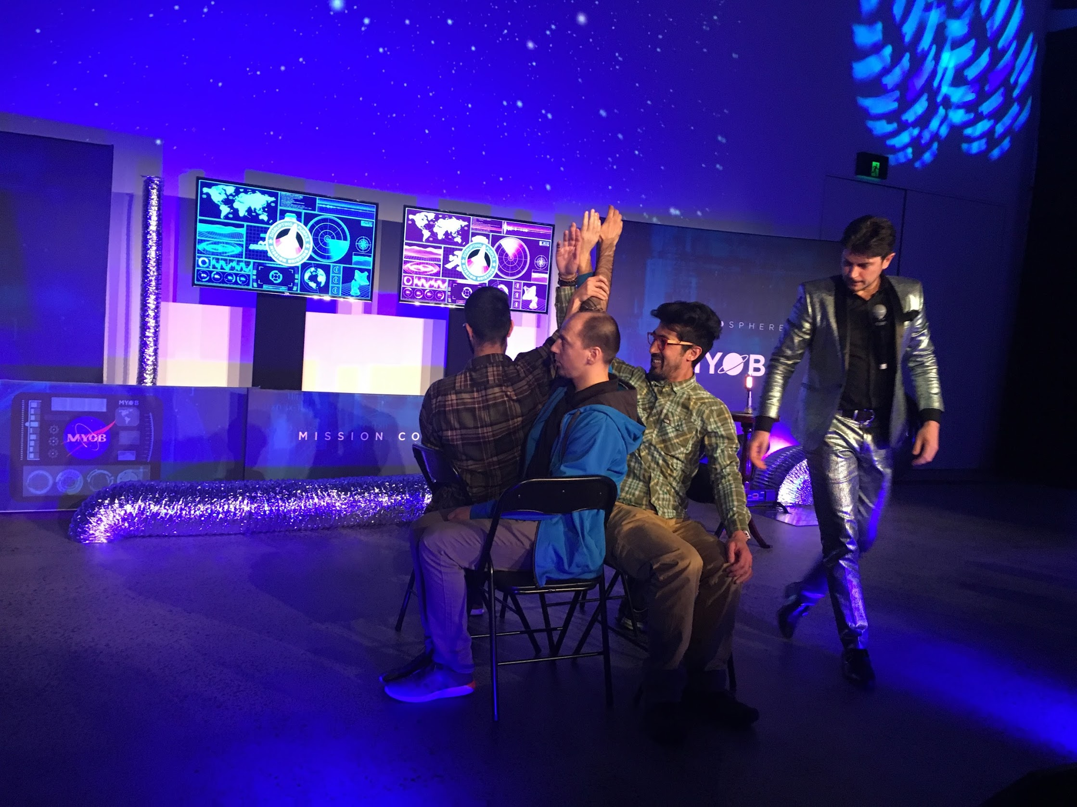
Disrupting Purple
Our first official company event – rocket ships, dancing storm troopers and awesome sweet treats, plus watching these guys do incredible feats of strength! Blown away by the passion and culture of myob!

Slide 12
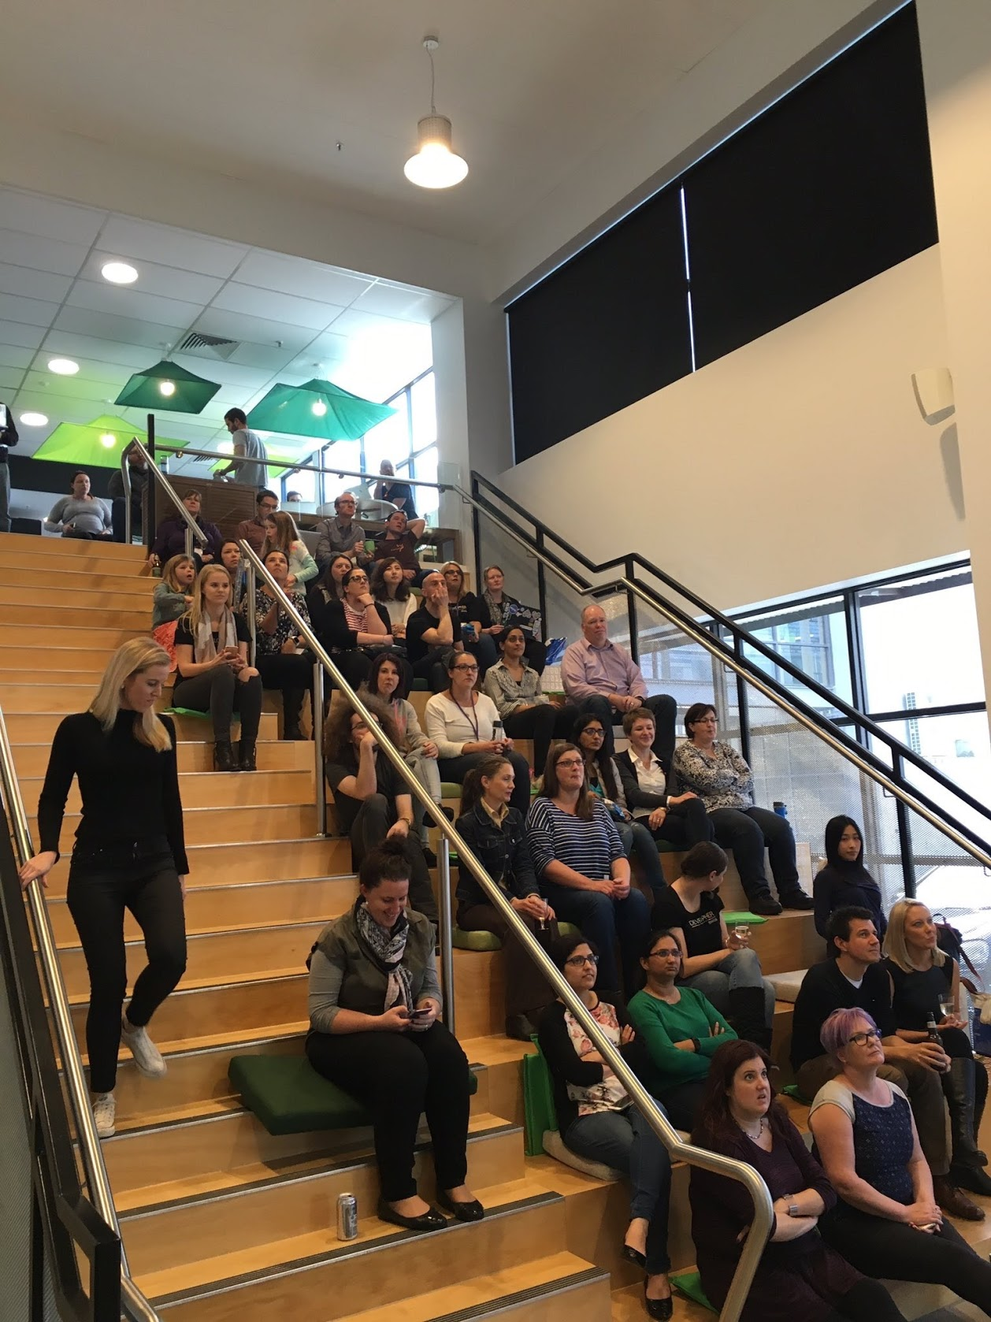
Code: Debugging The Gender Gap (A Documentary)
Description

Slide 13
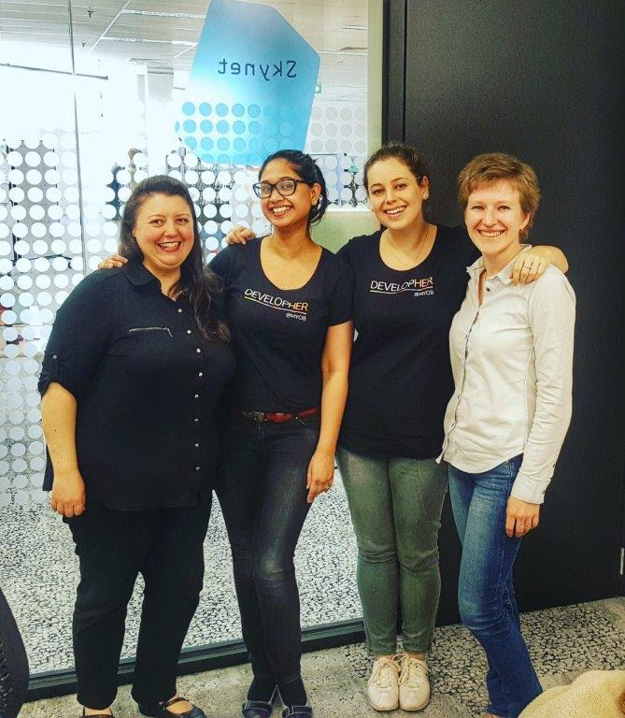
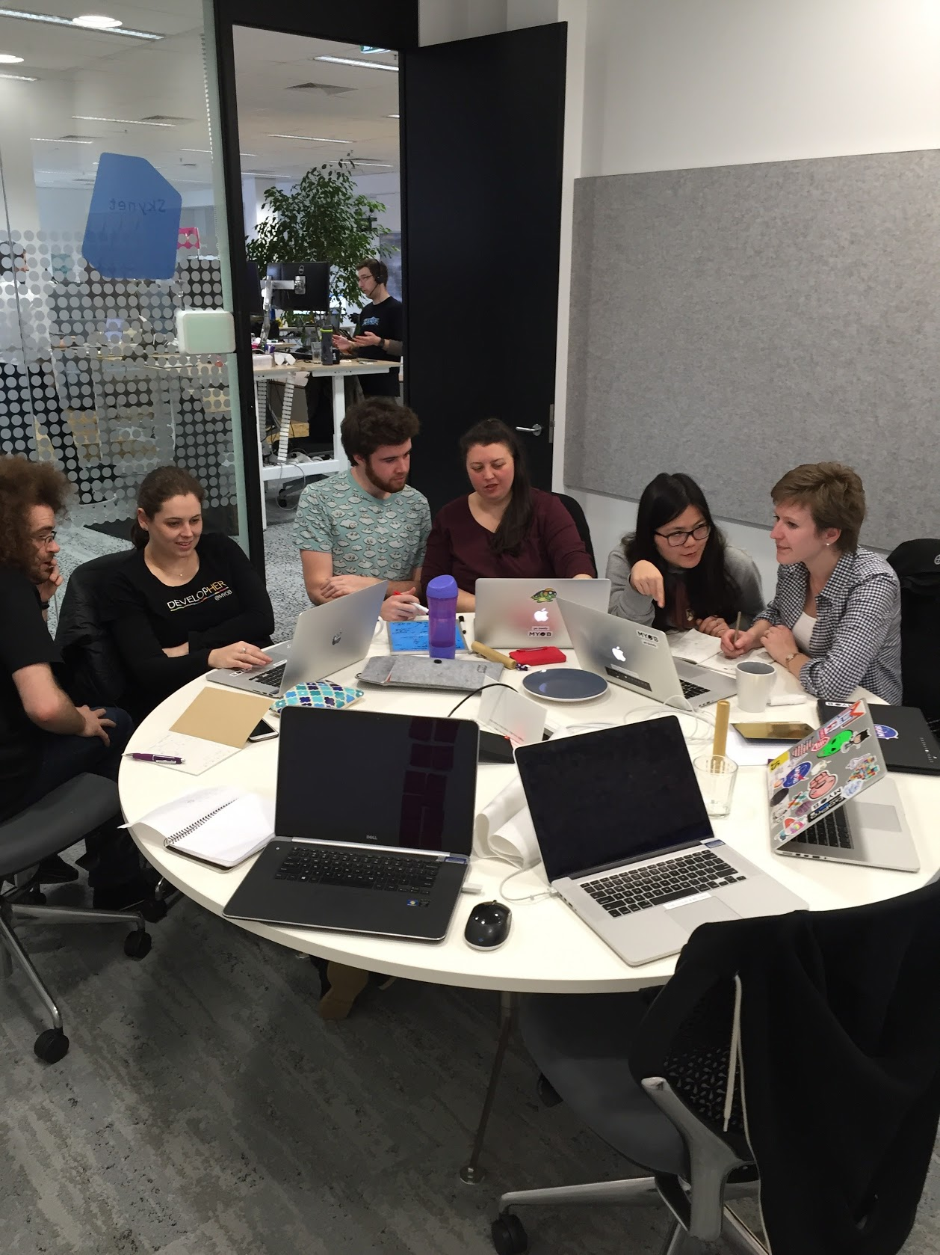
Classroom experience
Description

Slide 14
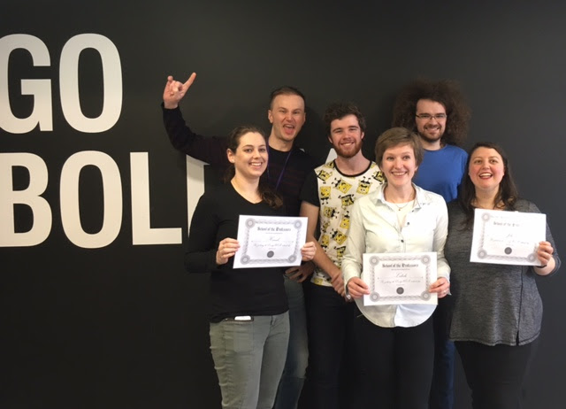
Graduation

Slide 15
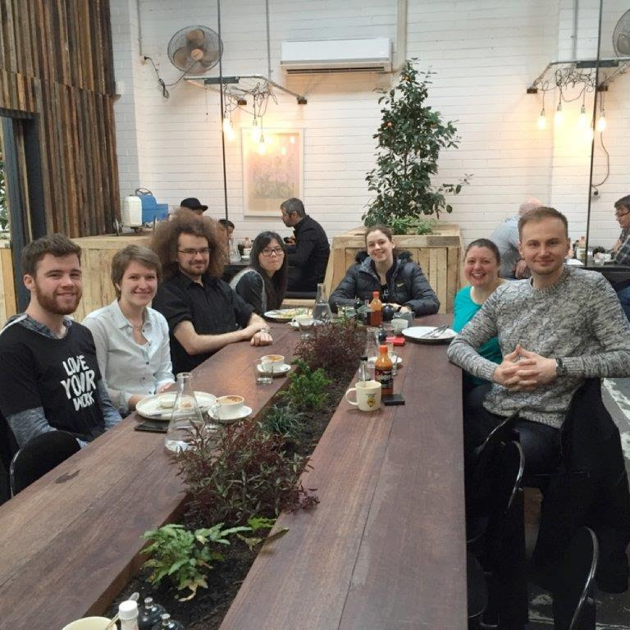
End of learning in the class
Description

Slide 16
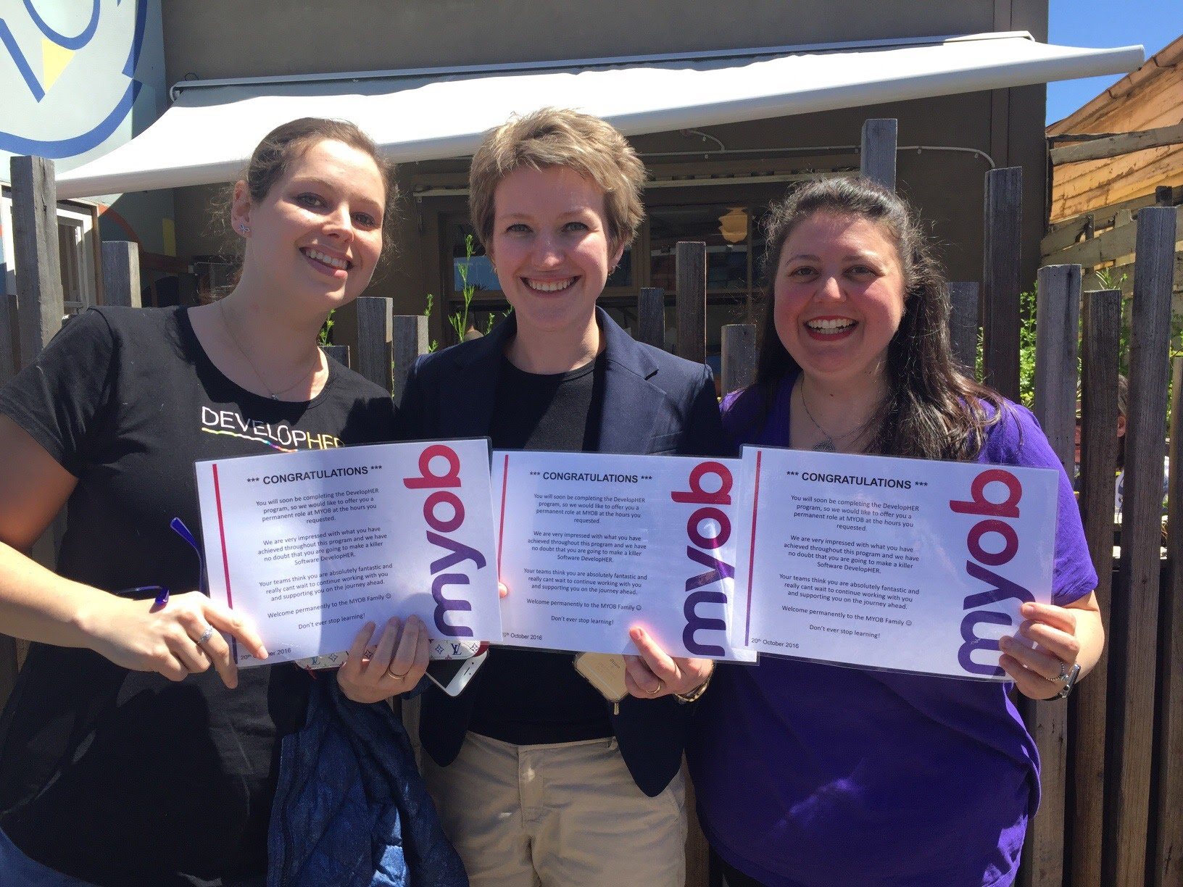
Graduate Developers
Description

Slide 17
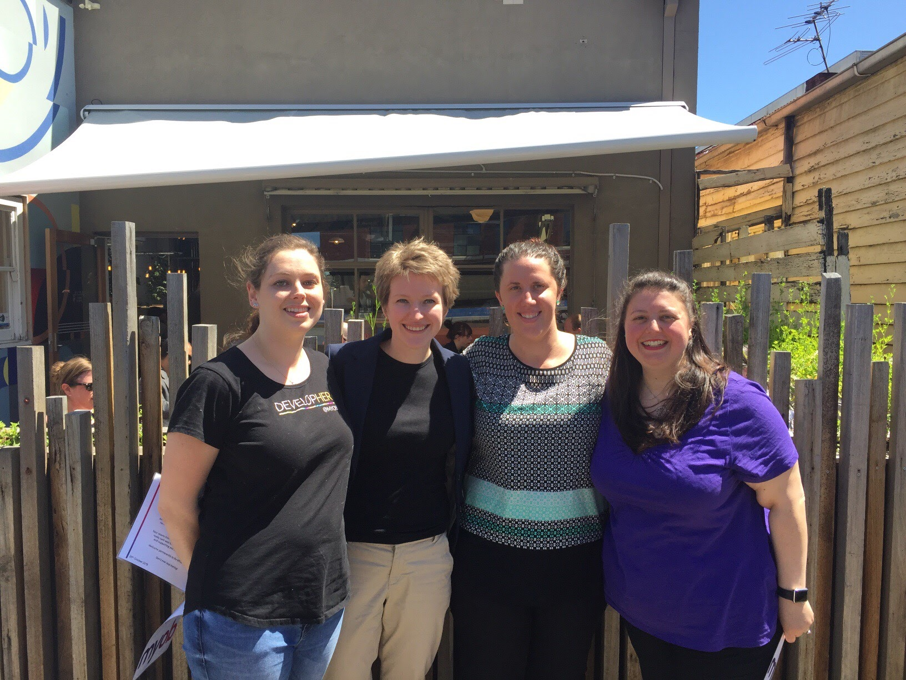
Contracts celebration
Description

Slide 18
Thank you
Tanya
John
Katherine
Simon
Andrew
Jonathan
Ognjen
Angela
Jeannie
Vivian
Mark
Dan
Michael
Clinton
Candice
Sally
Pooja
Prash
Jigger

